Slide 1
Compiler Design and Construction
Syntax Analyzer - Parser

Slide 2
Parsing
The scanner recognizes words
The parser recognizes syntactic units
Parser operations:
  Check and verify syntax based on specified syntax rules
  Report errors
  Build IR
Automation:
  The process can be automated

Slide 3
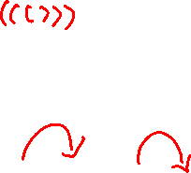
Context Free Grammar (CFG)
A CFG is a quadruple (N, T, R, S) where
  N is the set of non-terminal symbols
  T is the set of terminal symbols
  S ∈N is the starting symbol
  R ⊆ N×(N∪T)* is a set of rules
Eg: The grammar of nested parentheses
G = (N, T, R, S) where
  N = {S}
  T ={ (, ) }
  R ={ S→ (S) , S→SS, S→ε }
  * R ‘set of rule’ or P ‘rule of production’

Slide 4
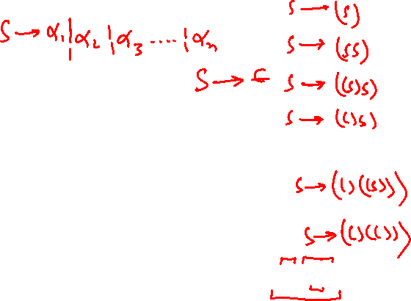
Derivations
The language described by a CFG is the set of strings that can be derived from the start symbol using the rules of the grammar.
At each step, we choose a non-terminal to replace.
S ⇒(S) ⇒(SS) ⇒((S)S) ⇒(( )S) ⇒(( )(S)) ⇒(( )((S))) ⇒(( )(( )))
sentential form
derivation
This example demonstrates a leftmost derivation : one where we always expand the leftmost non-terminal in the sentential form.

Slide 5
Derivations and parse trees
We can describe a derivation using a graphical representation called parse tree:
  the root is labeled with the start symbol, S
  each internal node is labeled with a non-terminal
  the children of an internal node A are the right-hand side of a production A→α
  each leaf is labeled with a terminal
A parse tree has a unique leftmost and a unique rightmost derivation.

Slide 6
Cont..
So, how can we use the grammar described earlier to verify the syntax of "(( )(( )))"?
  We must try to find a derivation for that string.
  We can work top-down (starting at the root/start symbol) or bottom-up (starting at the leaves).
Careful!
  There may be more than one grammars to describe the same language.
  Not all grammars are suitable

Slide 7
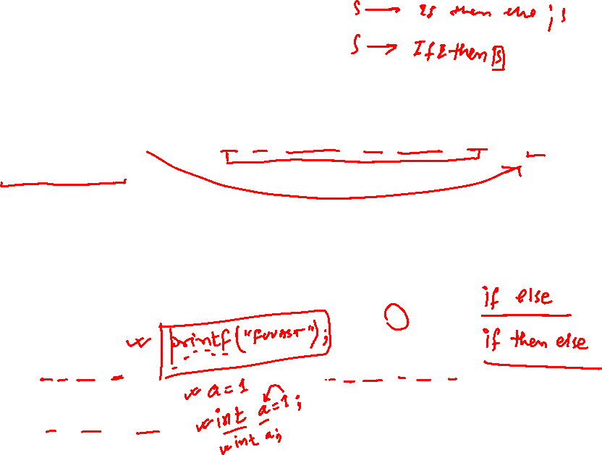
Problems in parsing
Consider S → if E then S else S | if E then S
  What is the parse tree for
  if E then if E then S else S
  There are two possible parse trees! This problem is called ambiguity
A CFG is ambiguous if one or more terminal strings have multiple leftmost derivations from the start symbol.
S
S
if E then S
if E then S else S
if E then S else S
if E then S

Slide 8
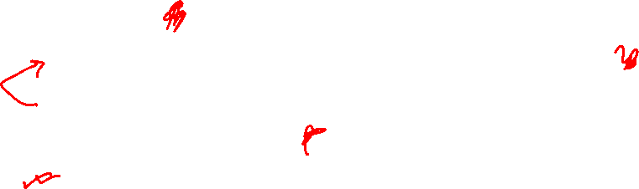
Ambiguity
A grammar is ambiguous if, for any string „
  it has more than one parse tree, or „
  there is more than one right-most derivation, or „
  there is more than one left-most derivation
  (the three conditions are equivalent)

Slide 9
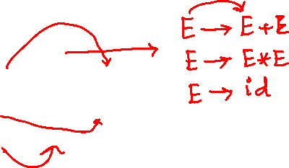
Ambiguity
There is no general algorithm to tell whether a CFG is ambiguous or not.
There is no standard procedure for eliminating ambiguity.
In general, we try to eliminate ambiguity by rewriting the grammar.
Example:
  E→E+E | E∗E | id
  becomes: E→E+T | T
  T→T∗E | E
  E→ id

Slide 10
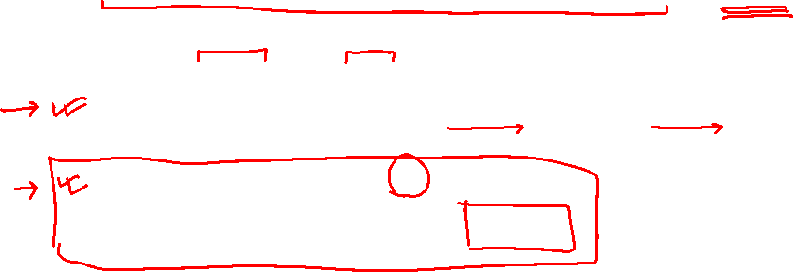
Cont..
In general, we try to eliminate ambiguity by rewriting the grammar.
Example:
  S→if E then S else S | if E then S | other
  becomes:
  S → E_{withElse} | E_{noElse}
  E_{withElse} → if E then E_{withElse} else E_{withElse} |
  other
  E_{noElse} → if E then S
  | if E then E_{noElse}

Slide 11
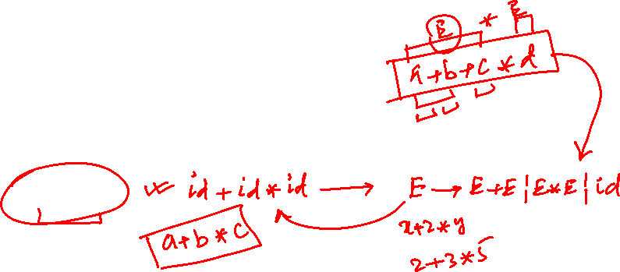
Top-down parsing
Main idea:
  Start at the root, grow towards leaves
  Pick a production and try to match input
  May need to backtrack
Example:
  Use the expression grammar to parse x-2*y

Slide 12
Grammar problems
Because we try to generate a leftmost derivation by scanning the input from left to right, grammars of the form
A → A x may cause endless recursion.
Such grammars are called left-recursive and they must be transformed if we want to use a top-down parser.

Slide 13
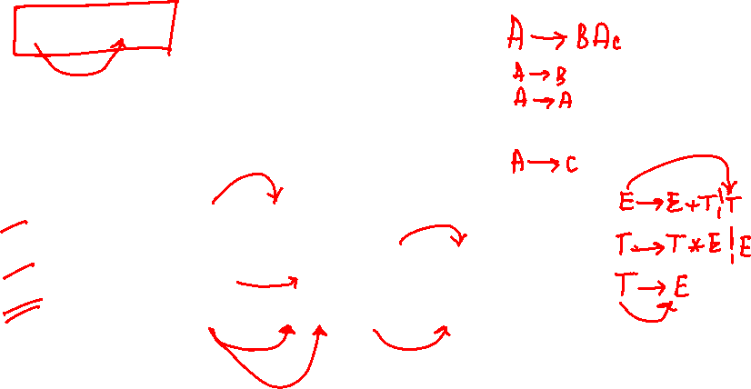
Left recursion
A grammar is left recursive if for a non-terminal A, there is a derivation A ⇒ Aα
There are three types of left recursion:
  direct (A → A x)
  indirect (A → B C, B → A )
  hidden (A → B A, B → ε)

Slide 14
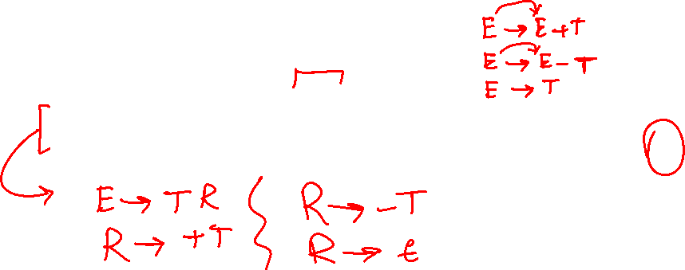
Cont..
Remove the left recursion in the following grammar:
expr → expr + term | expr - term
expr → term
solution:
expr → term rest
rest → + term rest | - term rest | ε

Slide 15
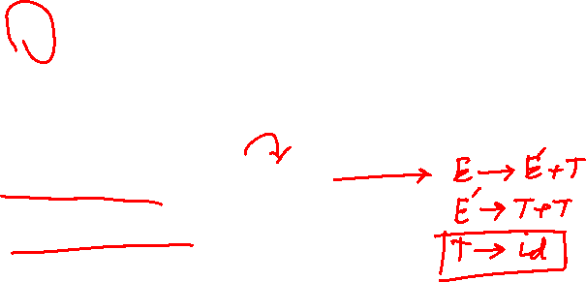
Cont..
To eliminate direct left recursion replace
A → Aα₁ | Aα₂ | ... | Aα_{m} | β₁ | β₂ | ... | β_{n}
with
A → β₁B | β₂B | ... | β_{n}B
B → α₁A | α₂A | ... | α_{m}A | ε
There is direct recursion: E→E+T
There is indirect recursion: T→E+T, E→T

Slide 16
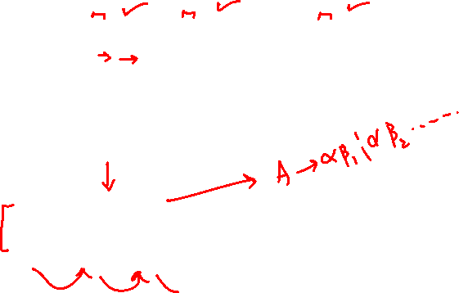
Left factoring
A → αβ₁ | αβ₂ |...| αβ_{n} | γ
becomes
  A → αB| γ
  B → β₁ | β₂ |...| β_{n}

Slide 17
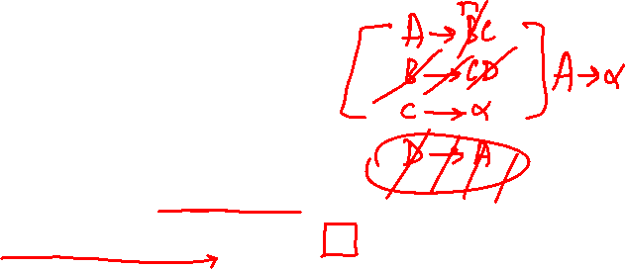
Grammar problems
A symbol X∈V is useless if
  there is no derivation from X to any string in the language (non-terminating)
  there is no derivation from S that reaches a sentential form containing X (non-reachable)
Reduced grammar = a grammar that does not contain any useless symbols.

Slide 18
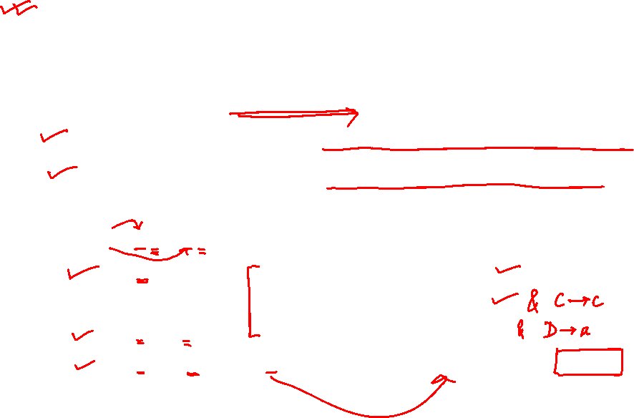
Useless symbols
In order to remove useless symbols, apply two algorithms:
  First, remove all non-terminating symbols
  Then, remove all non-reachable symbols.
Initial grammar:
S→ AB | CA
A→ a
B→ CB | AB
C→ cB | b
D→ aD | d
Algorithm 1 (terminating symbols):
A is in because of A→ a
C is in because of C→ b
D is in because of D→ d
S is in because A, C are in and S→ CA

Slide 19
Cont..
Example Cont..
After algorithm 1:
S→ CA
A→ a
C→ b
D→ aD | d
Algorithm 2 (reachable symbols):
S is in because it is the start symbol
C and A are in because S is in and S→ CA
Final grammar:
S→ CA
A→ a
C→ b

Slide 20
Example..
Write productions of grammar for language L={9-5*2} or L={id1+id2*id3} or L={a+b*c}.
Also write the {S, N, P, T} of grammar. State weather its ambiguous or unambiguous grammar? Draw the parse tree of it and write left most and right most derivation of it.

Slide 21
Productions of grammar
expr → expr + expr
    → expr * expr
    → expr
    → id
    id → a|b|c
OR
expr → expr + term
→ expr * term
→ term
term → id
    id → a|b|c
S = expr
N = {expr, id}
{expr, term,id}
T = {a,b,c}

Slide 22
Parse tree
expr
expr
expr
+
expr
expr
*
expr
id
*
+
id
expr
expr
expr
expr
a
c
id
id
id
id
b
c
a
b
Left parse tree
Right parse tree
In left parse tree, multiplication is generated lower in tree, which
Could indicate that it has precedence over the addition.

Slide 23
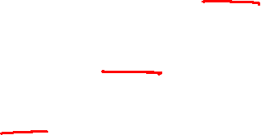
Leftmost and rightmost derivations
expr → expr + term
→ term + term
→ id + term
→ a + term
→ a + term * term
→ a + id * term
→ a + b * term
→ a + b * id
→ a + b * c
expr → expr + term
→ expr + term * term
→ expr + term * id
→ expr + term * c
→ expr + id * c
→ expr + b * c
→ term + b * c
→ id + b * c
→ a + b * c
Leftmost derivation
Rightmost derivation

